Slide 1
Horizon task instructions

Slide 2
Welcome! You will get to play the stacked boxes game.

Slide 3
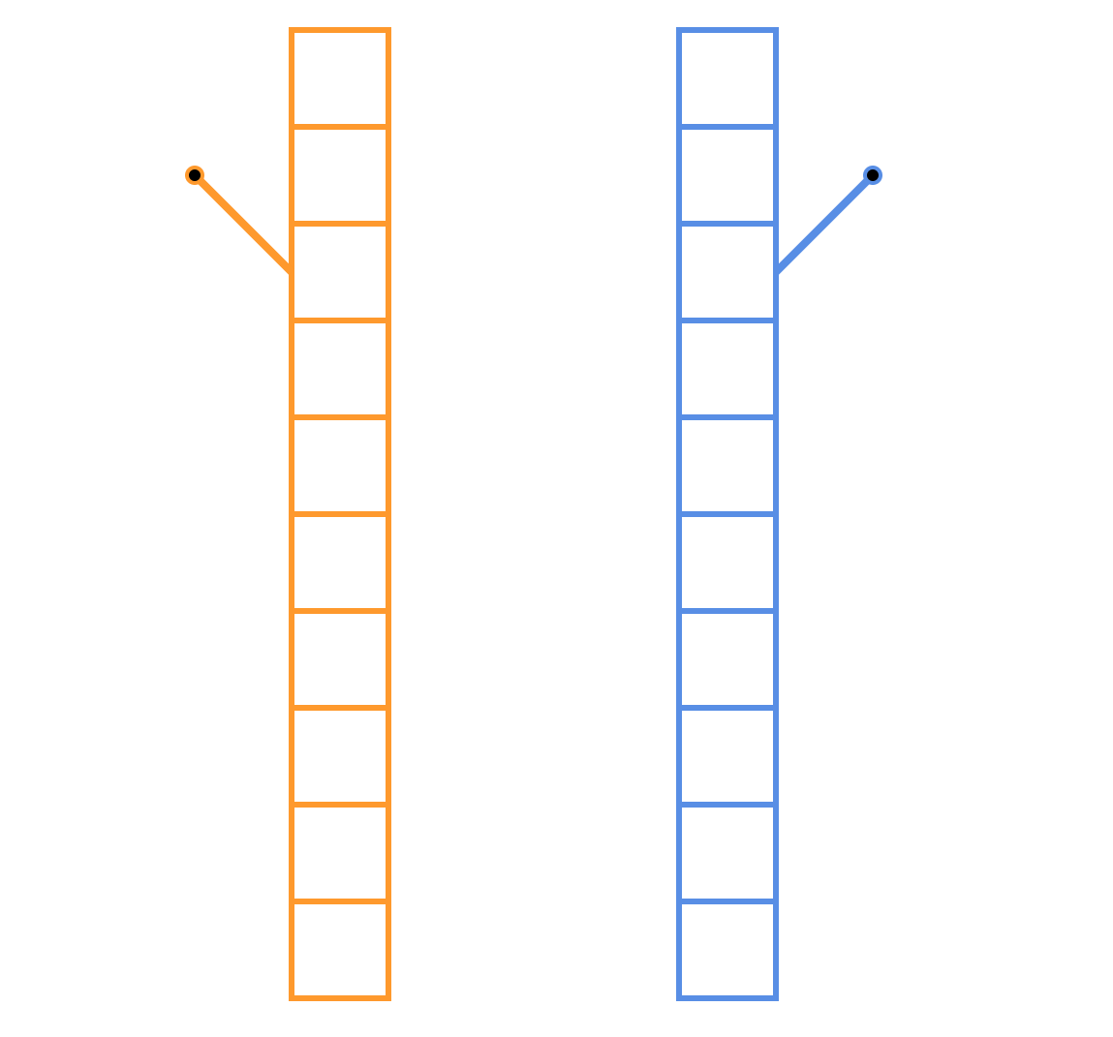
You get to choose between two stacks of boxes.

Slide 4
The stacks of boxes look like this

Slide 5
Every time you choose one stack, the lever on the side will be pulled like this ...

Slide 6
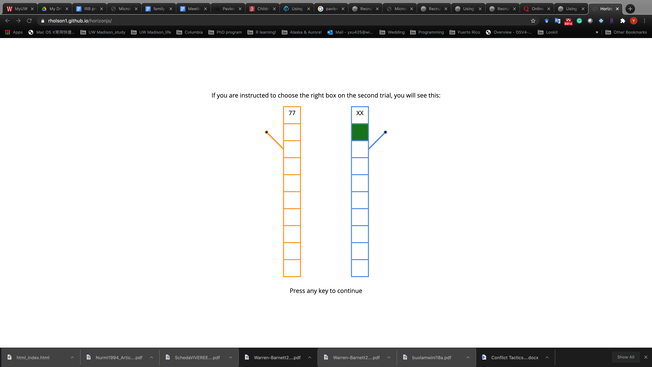
When the lever is pulled you will see how many points you got!

Slide 7
So if you chose the left orange stack you get 77 points.

Slide 8
Most of the time all the boxes in a stack have the same points, but some may give you more or less points than others.

Slide 9
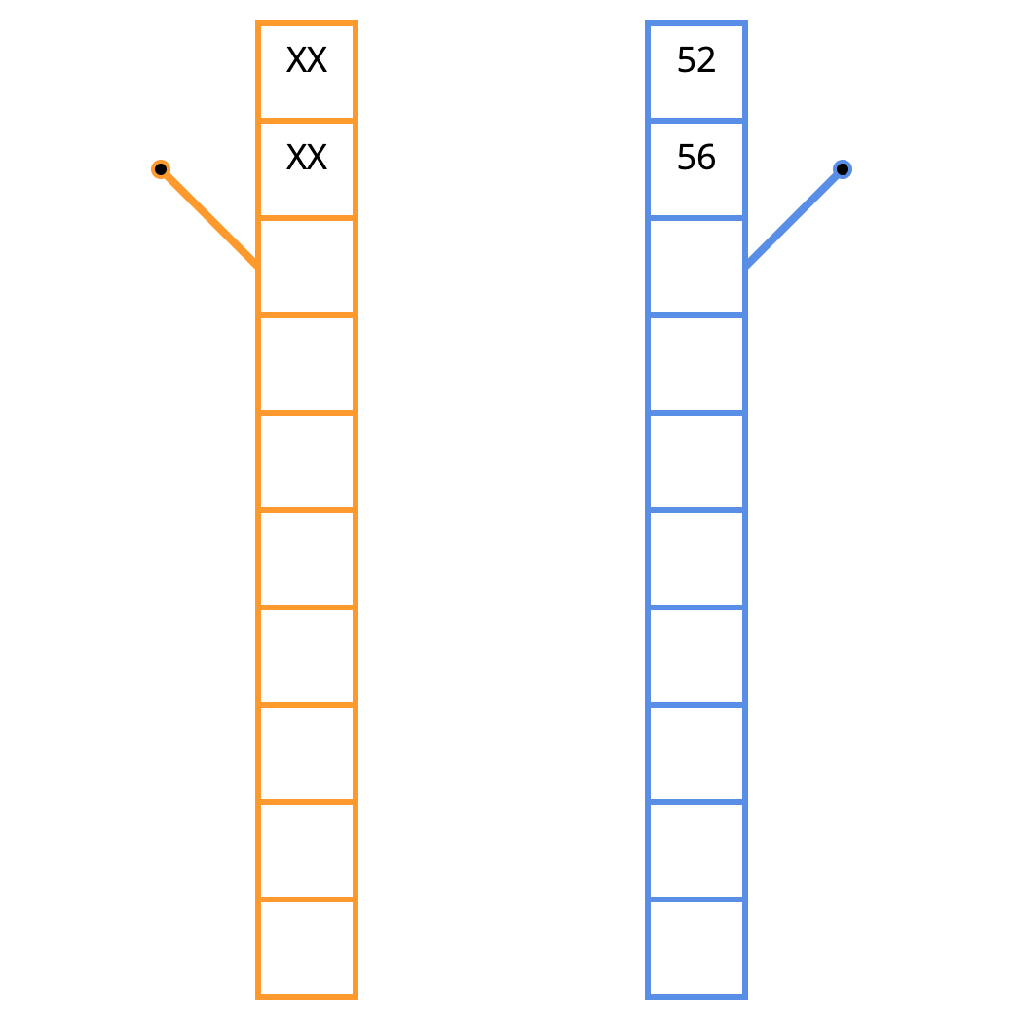
For example, in the blue stack on the right, the first box gave 52 points and the second box gave 56 points. So the number of points is about the same in the boxes.

Slide 10

A third box has 45 points, so a little less, but close to the other boxes in the stack.

Slide 11
On each game, either the left orange stack or the right blue stack will have boxes worth more points. You get to choose which stack to pick.

Slide 12
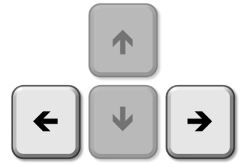
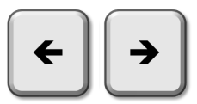
To make your choice: Press < to play the left orange stack Press > to play the right blue stack

Slide 13
You can tell how many choices you will have by the number of boxes. If the stack is 10 boxes high, that means you get 10 guesses...

Slide 14
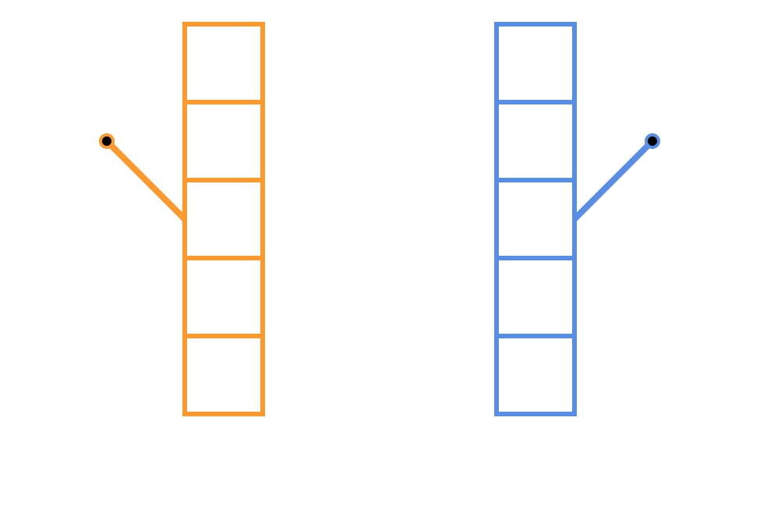
If there are 5 boxes then you only get 5 guesses.

Slide 15
To help you earn points, we will tell you which stack to choose for your first 4 choices.

Slide 16
There will be a green square inside the box we want you to open and you must press the button to choose this stack to get your points. Here you would choose the orange stack on the left.

Slide 17
Here you would choose the blue stack on the right.

Slide 18
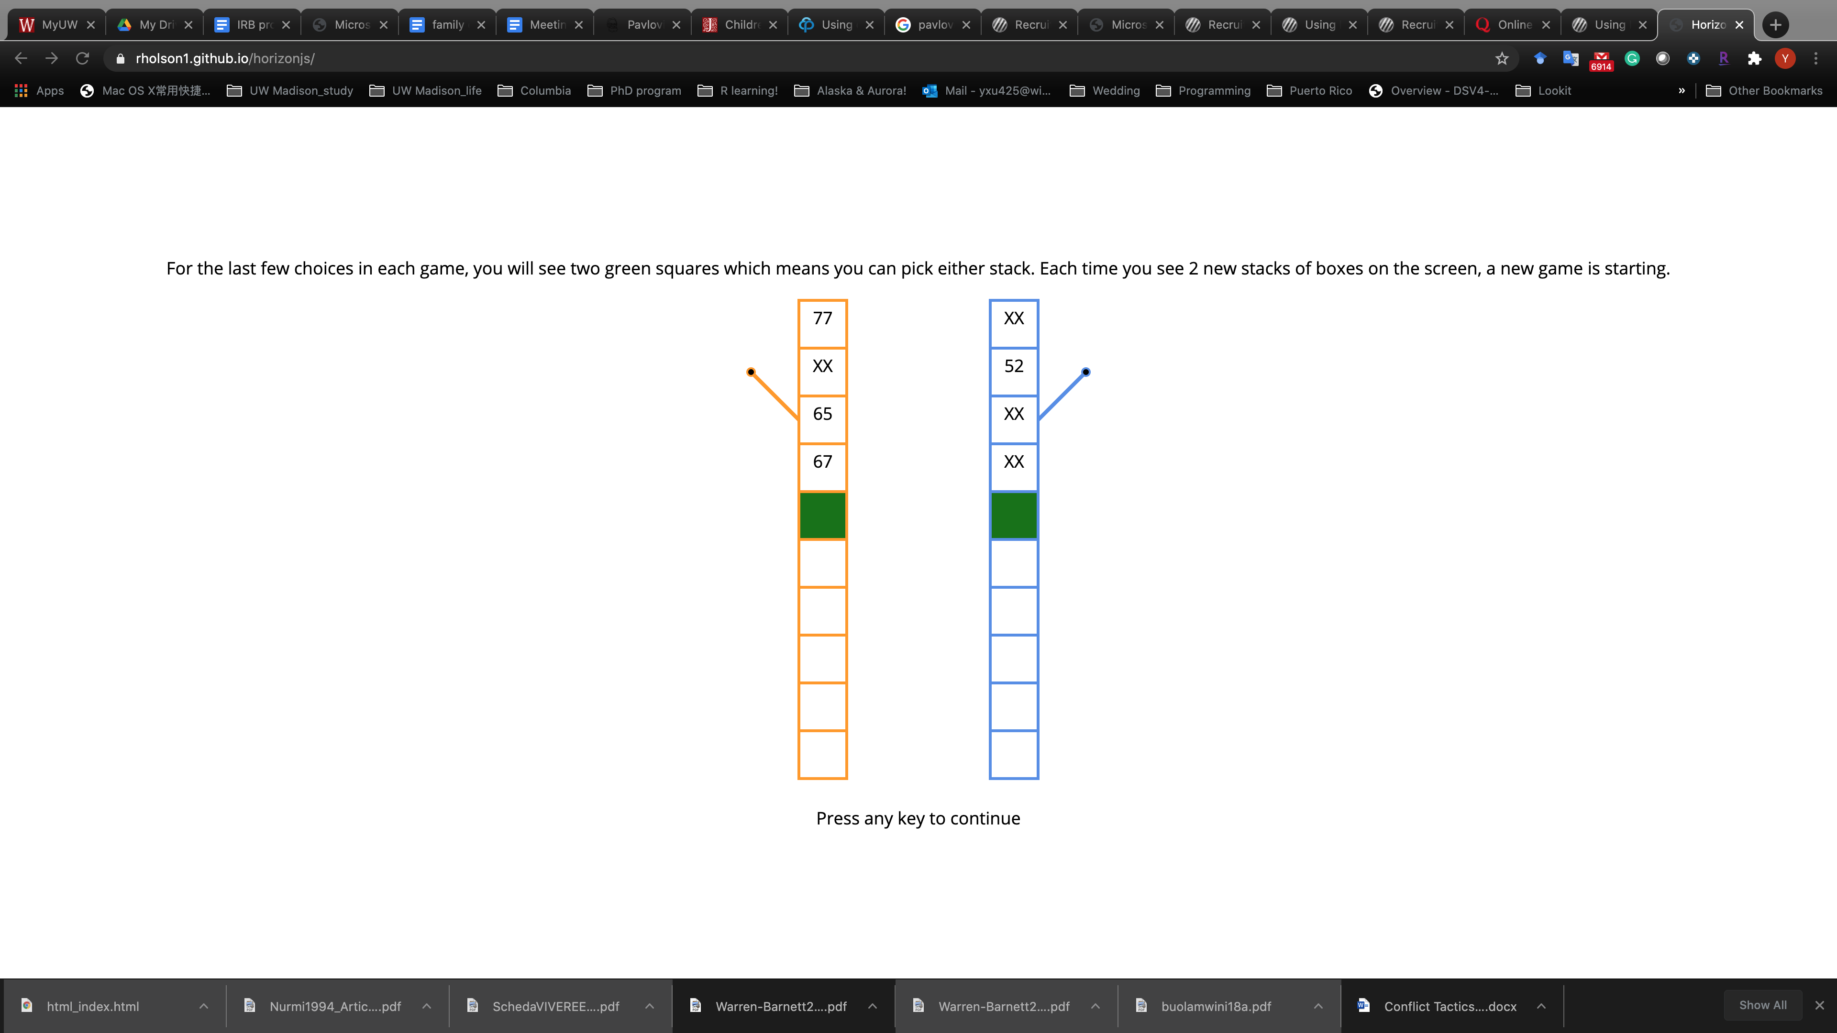
When you will see TWO green squares you get to pick the one that you want.

Slide 19
So ... to be sure that everything makes sense let's go through some questions ...

Slide 20
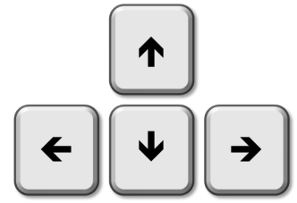
Remember, if you want to play the left stack:
Press this key
Press any key to continue

Slide 21
If you want to play the right stack:
Press this key
Press any key to continue

Slide 22
Which key to press? Please respond with your keyboard.
Notes:
IT IS CONFUSING THST THERE RE 2 DIFFERENT QUESTIONS ON ONE SLIDE

Slide 23
What can you do here? Please press “a”, “b”, or “c” on your keyboard.
Press
Press
Press either or
Notes:
IT IS CONFUSING THST THERE RE 2 DIFFERENT QUESTIONS ON ONE SLIDE

Slide 24
What is true about the ORANGE boxes? Please press “a” or “b” on your keyboard.
They will all be around 40.
They can be any number.
40
Notes:
IT IS CONFUSING THST THERE RE 2 DIFFERENT QUESTIONS ON ONE SLIDE

Slide 25
Which side may get you more points in general? Please respond with your keyboard.
50
XX
XX
80
XX
76
XX
92
Notes:
If they get it wrong, they’ll see: the other set of boxes has higher points on average, so you should press [left/right arrow] to choose the other side.

Slide 26

50
XX
XX
80
XX
76
This side will give you more points.
XX
92
Notes:
If they get it wrong, they’ll see: the other set of boxes has higher points on average, so you should press [left/right arrow] to choose the other side.

Slide 27
Which side may get you more points in general? Please respond with your keyboard.
25
XX
23
XX
26
XX
XX
65
Notes:
If they get it wrong, they’ll see: the other set of boxes has higher points on average, so you should press [left/right arrow] to choose the other side.

Slide 28
25
XX
23
XX
26
XX
This side will give you more points.
XX
65
Notes:
If they get it wrong, they’ll see: the other set of boxes has higher points on average, so you should press [left/right arrow] to choose the other side.

Slide 29
Which side may get you more points in general? Please respond with your keyboard.
76
XX
80
XX
XX
50
XX
65
Notes:
If they get it wrong, they’ll see: the other set of boxes has higher points on average, so you should press [left/right arrow] to choose the other side.

Slide 30
76
XX
80
XX
This side will give you more points.
XX
50
XX
65
Notes:
If they get it wrong, they’ll see: the other set of boxes has higher points on average, so you should press [left/right arrow] to choose the other side.

Slide 31
Press space when you are ready to begin the game. Good luck!

